Slide 1

Introduction to UnSupervised Learning
With AutoEncoders, RBM and Deep Belief Net
Rishikesh
rishikksh20@gmail.com
https://github.com/rishikksh20

Slide 2
Agenda:
Introduction to Deep Learning
Discriminative Models vs Generative Models
Autoencoder
Types of Autoencoder
Restricted Boltzmann Machine
Deep Belief Network
Fine Tuning

Slide 3
Deep Learning
Deep learning refers to artificial neural networks that are composed of many layers.
Multiple layers work to build an improved feature space
First layer learns 1st order features (e.g. edges…)
2nd layer learns higher order features (combinations of first layer features, combinations of edges, etc.)
In current models layers often learn in an unsupervised mode and discover general features of the input space – serving multiple tasks related to the unsupervised instances (image recognition, etc.)
Final layer features are fed into supervised layer(s).

Slide 4
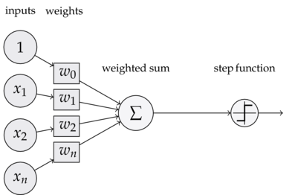
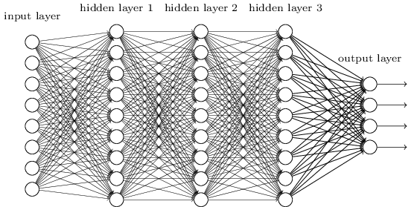
Deep Learning

Slide 5
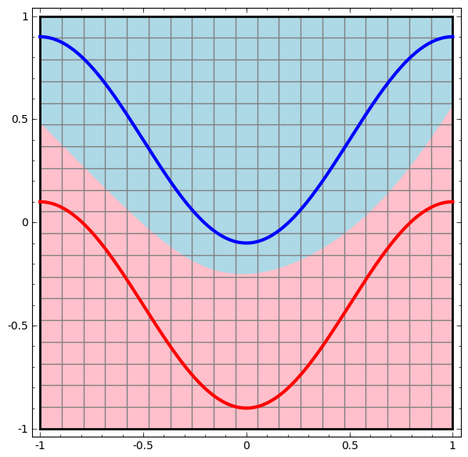
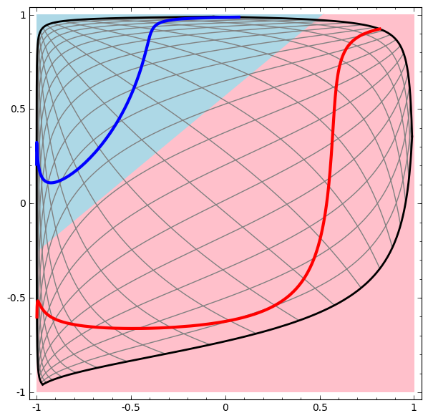
Instead of draw complex decision boundary, DNN transform feature space in such a way that the decision boundary easily separate two classes.

Slide 6
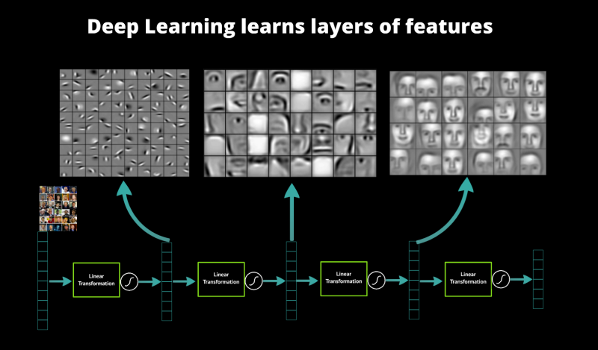
Learning HierarchicaL Representations

Slide 7
Discriminative Model
Vs
Generative Model
1) Learning each language and then classifying it using the knowledge you just gained.
2) Determining the difference in the linguistic models without learning the languages and then classifying the speech.
the first one is the Generative Approach and the second one is the Discriminative approach.
Generative Methods –
Generative models model the distribution of individual classes.
Popular models • Gaussians, Naïve Bayes, Mixtures of multinomials • Mixtures of Gaussians, Mixtures of experts, Hidden Markov Models (HMM) • Sigmoidal belief networks, Bayesian networks, Markov random fields •
Discriminative Methods –
Discriminative models learn the (hard or soft) boundary between classes.
No attempt to model underlying probability distributions
Focus computational resources on given task and better performance
Popular models • Logistic regression, SVMs • Traditional neural networks, Nearest neighbor • Conditional Random Fields (CRF)

Slide 8
Unsupervised Learning
Autoencoders
Deep Autoencoders
Sparse Autoencoders
Denoising Autoencoders
Restricted Boltzmann Machine
Deep Belief Network

Slide 9
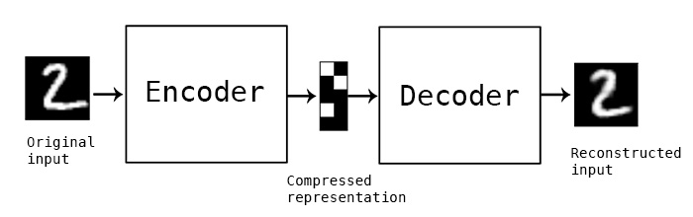
Autoencoders
An autoencoder is an feed forward neural network used for unsupervised learning which takes a set of typically unlabelled inputs and encode them. After Encoding it tries to reconstruct them as accurate as possible.
Aim of autoencoder is to learn a representation (probability density function) for a set of data which is extremely useful to figure-out the underlying structure of the Data set.
Architecture of Autoencoder:
Encoder
Bottleneck Layer
Decoder

Slide 10
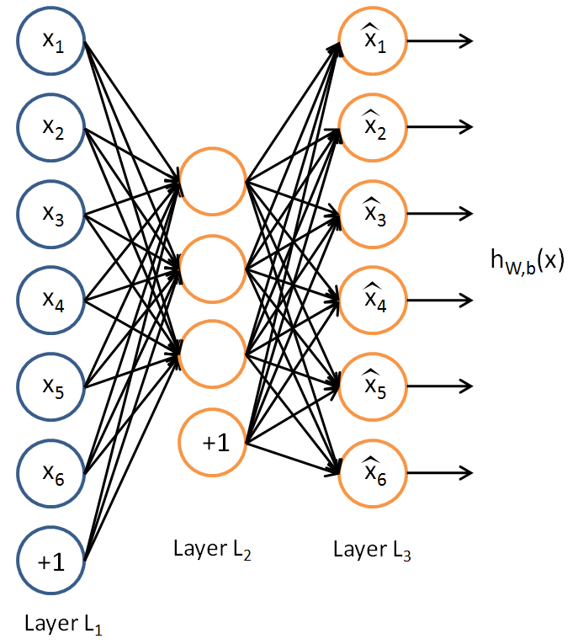
The number of hidden layer and number of neuron in each layer remain same in encoder and decoder network.Typically same weights that are used in ecode feature as well as decode.
The input and output layers of the autoencoder has same size.
Bottleneck Layer:
Middle hidden layer between Encoder and Decoder in which number of neuron less than the input neuron.
Highlight only input features which represent this kind of data the best with a much smaller number of neurons.
Due to highlighting only important features Deep autoencoders are extremely useful for data compression and dimensionality reduction.
Autoencoders are trained with backpropagation using a metric called “Loss”.
Loss measures the amount of information lost when net tried to reconstruct the input.

Slide 11
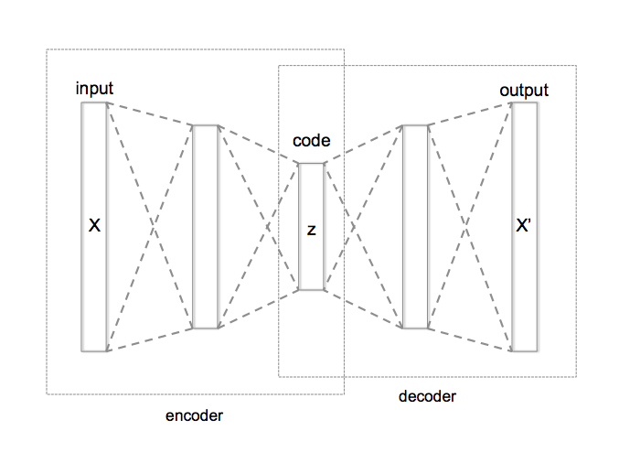
Types of AutoEncoder:
Fully Connected Autoencoder
Fully Connected Deep Autoencoder
Sparse Autoencoder
Convolutional Autoencoder
Denoising Autoencoder
Variational Autoencoder

Slide 12
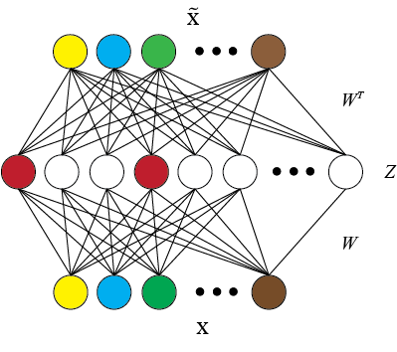
Sparse Autoencoder:
Here number of neuron in each hidden layer more than the input and output layer.
For a given hidden node, it’s average activation value (over all the training samples) should be a small value close to zero, e.g., 0.5
A term is added to the cost function which increases the cost if the above is not true.

Slide 13
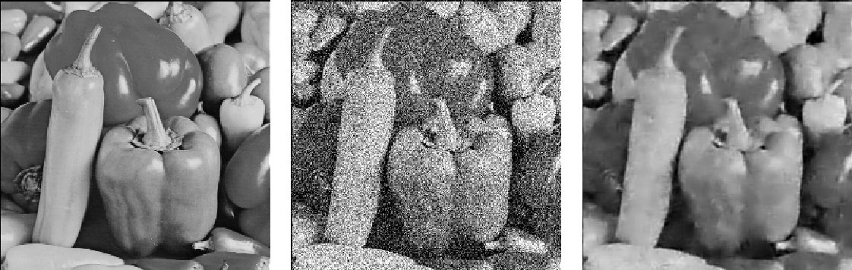
Denoising Autoencoder :
In order to force the hidden layer to discover more robust features and prevent it from simply learning the identity, we train the autoencoder to reconstruct the input from a corrupted version of it.

Slide 14
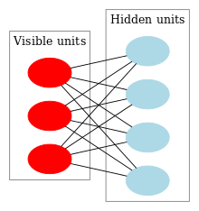
Restricted Boltzmann Machine :
Restricted Boltzmann machines are some of the most common building blocks of deep probabilistic models.
A generative stochastic artificial neural network that can learn a probability distribution over its set of inputs.
RBM is a shallow two layer net, the first layer is known as visible layer and the second is called a hidden layer.
RBM training consists three steps:
Forward pass
Backward Pass
KL Divergence
KL divergence measures the similarity of some distribution A to another distribution B.

Slide 15
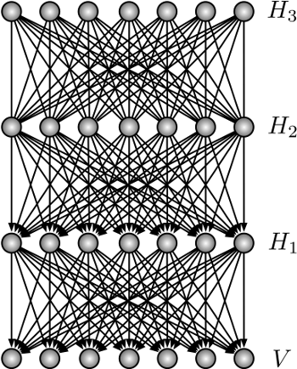
Deep Belief Network :
Stack of RBMs which result as deep network.
Deep Belief is identical to a Multilayer Perceptron, but structure is where their similarities end.
DBN has a radically different training method which allows it to tackle the vanishing gradient.
The method is known as Layer-wise, unsupervised, greedy pre-training.
Essentially, the DBN is trained two layers at a time, and these two layers are treated like an RBM.

Slide 16
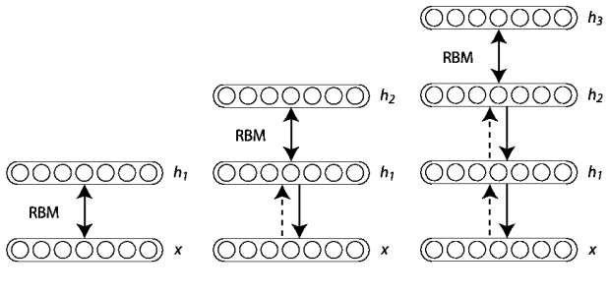
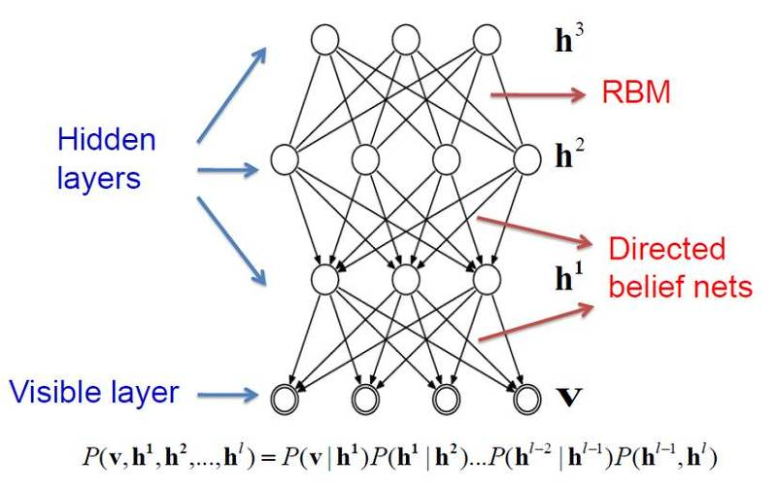
First RBM is trained, and its outputs are then used as inputs to the next RBM. This procedure is repeated until the output layer is reached.
After this training process, the DBN is capable of recognizing the inherent patterns in the data. In other words, it’s a sophisticated, multilayer feature extractor. The unique aspect of this type of net is that each layer ends up learning the full input structure.

Slide 17
Fine Tuning:
Till now DBN work as Unsupervised Learning and initialize weights of the network which often called pre-training of Deep Neural network.
DBN still requires a set of labels to apply to the resulting patterns.
As a final step, the DBN is fine-tuned with supervised learning and a small set of labeled examples.
After making minor tweaks to the weights and biases, the net will achieve a slight increase in accuracy as compared to random weight initialization.
Fine tuning beats the vanishing gradient problem.

Slide 18
Thanks
Questions ?

